Slide 1
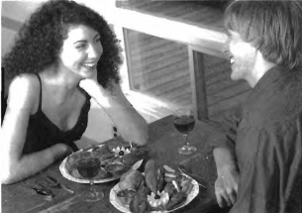

Slide 2
(A) The plates are full of food.
(B) The man and woman have finished eating.
(C) The man has already eaten.
(D) The woman has no food.

Slide 3
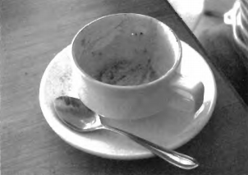

Slide 4
(A) The coffee cup has a spoon in it.
(B) The coffee cup is empty.
(C) A man is drinking coffee.
(D) A woman is drinking coffee.

Slide 5
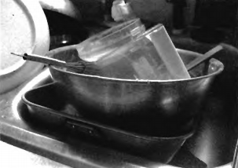

Slide 6
(A) The dishes are next to the sink.
(B) The sink is full of dishes.
(C) The dishes are broken.
(D) The sink is full of water.

Slide 7
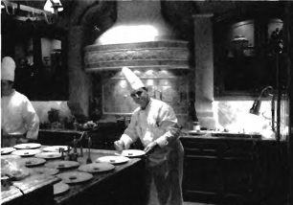

Slide 8
(A) The man is preparing food.
(B) The man is drying dishes.
(C) The man is eating lunch.
(D) The man is cleaning the kitchen.

Slide 9
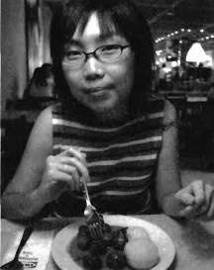

Slide 10
(A) The woman is eating lunch with friends.
(B) The woman is eating at home.
(C) The woman doesn’t have a fork.
(D) The woman is holding a fork.

